Slide 1

ENCRYPTION AND DECRYPTION USING BLOWFISH ALGORITHM
A COMPUTER NETWORKS MINOR PROJECT ON
Guided By:
Mr. K. JANAKI RAM
ASSISTANT PROFESSOR
VFSTR
Presented By:
E. SHARAN (181FA05087)
K. TANUJA (181FA05222)
M. HARI KRISHNA (181FA05225)

Slide 2
OBJECTIVE
In the fields of information security and cryptography, encryption is the process of encoding a message or information in a way that only authorized parties can access it and those who are not authorized cannot.
In this project, data is encrypted and decrypted using BLOWFISH ALGORITHM

Slide 3
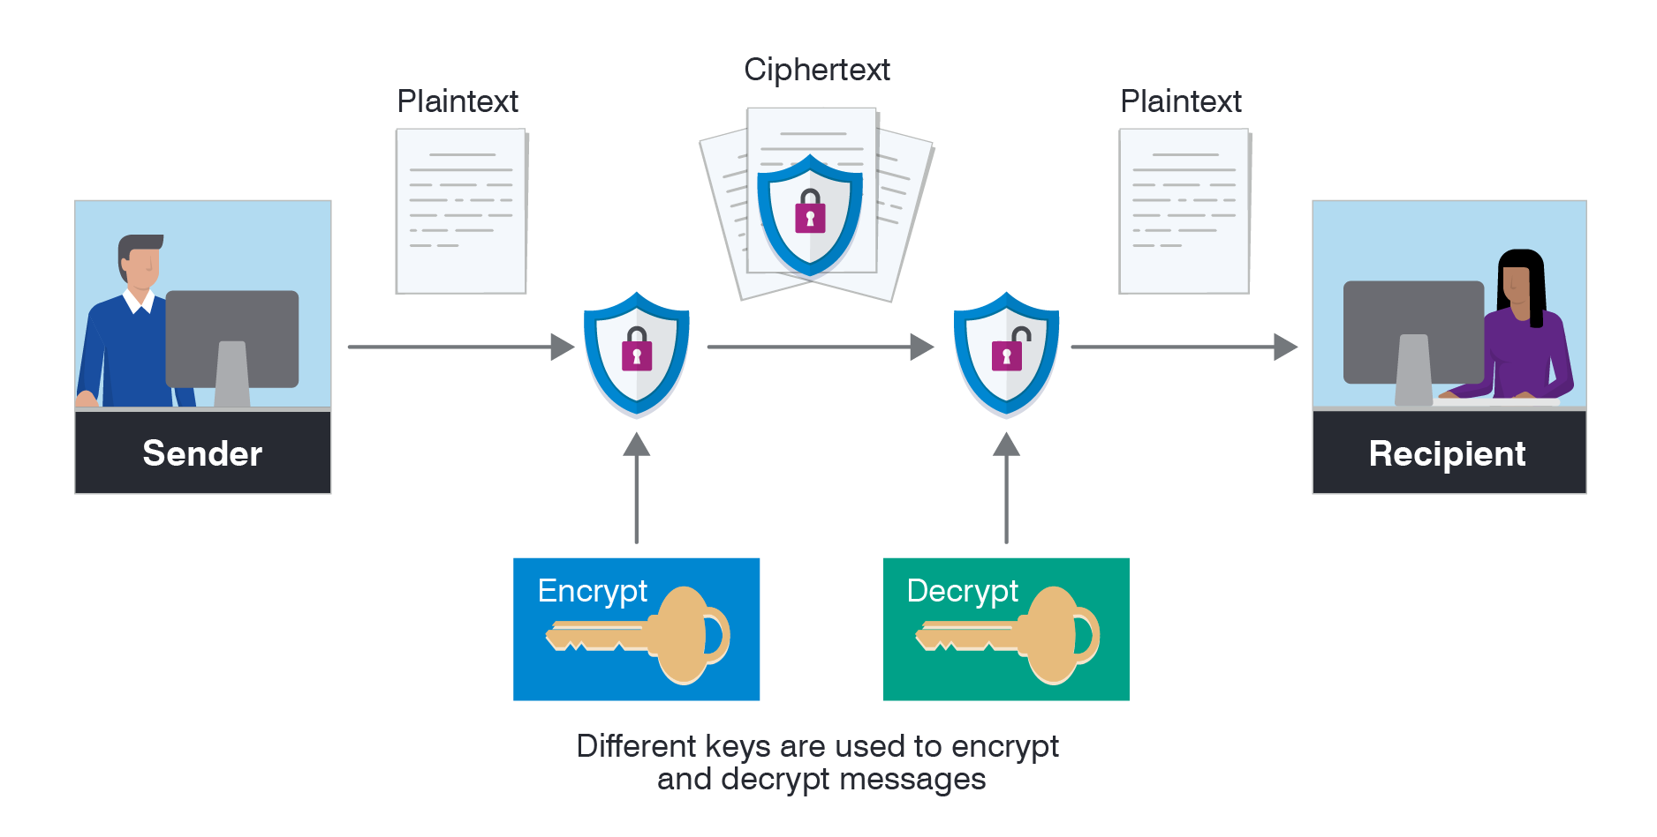
HOW ENCRYPTION WORKS

Slide 4
BLOWFISH ALGORITHM
Blowfish is an encryption technique designed by Bruce Schneier in 1993 as an alternative to DES Encryption Technique.
It is significantly faster than DES (data Encryption Standard) and provides a good encryption rate.
It is one of the first, secure block ciphers not subjects to any patents and hence freely available for anyone to use.
Input Block Size: 64 bits
Key Size: 32 bits to 448 bits variable size
Number of subkeys : 18 [P- array]
Number of rounds: 16
Number of substitution boxes: 4 [each having 256 entries of 32 bits each]

Slide 5
ENCRYPTION USING BLOWFISH ALGORITHM

Slide 6
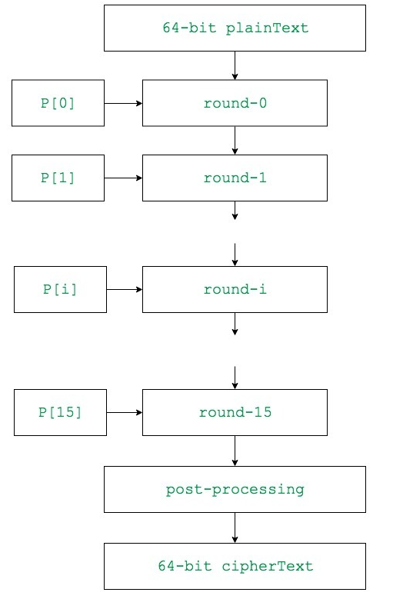
ENTIRE ENCRYPTION PROCESS

Slide 7
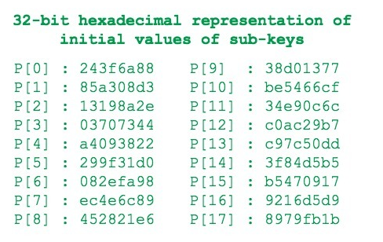
STEP 1: Generation of subkeys
P Array:
18 subkeys{P[0]…P[17]} are needed in both encryption as well as decryption process and the same subkeys are used for both the processes.
These 18 subkeys are stored in a P-array with each array element being a 32-bit entry.
It is initialized randomly in hexadecimal form.

Slide 8
Now each of the subkey is changed with respect to the input key as:
P[0] = P[0] XOR 1st 32-bits of input key
P[1] = P[1] XOR 2nd 32-bits of input key
.
.
.
P[i] = P[i] XOR (i+1)th 32-bits of input key
(roll over to 1st 32-bits depending on the key length)
.
.
.
P[17] = P[17] XOR 18th 32-bits of input key
(roll over to 1st 32-bits depending on key length)
The resultant P-array holds 18 subkeys that is used during the entire encryption process

Slide 9
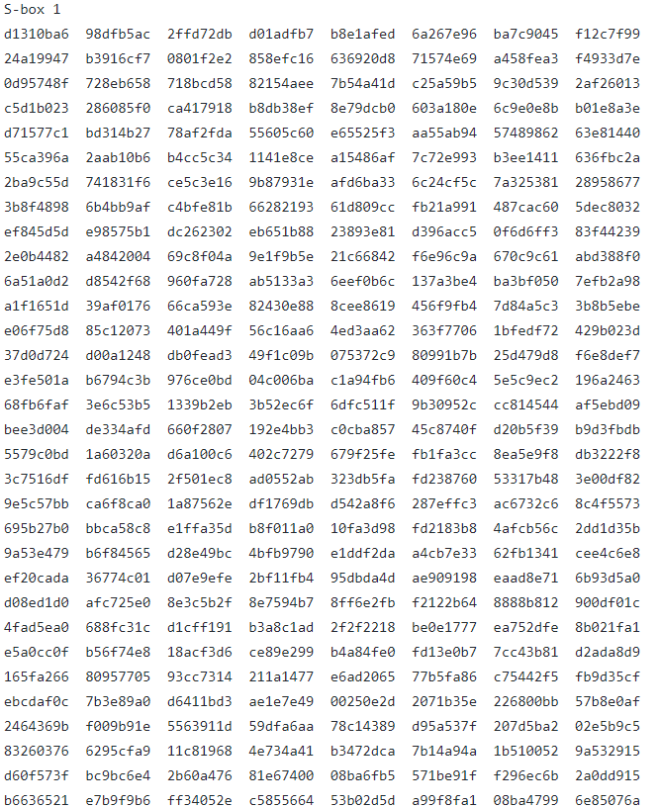
STEP 2: Initialise Substitution boxes
4 Substitution boxes(S-boxes) are needed{S[0]…S[3]} in both encryption as well as decryption process with each S-box having 256 entries{S[i][0]…S[i][255]} where each entry is 32-bit.
It is initialized randomly in Hexadecimal form.

Slide 10
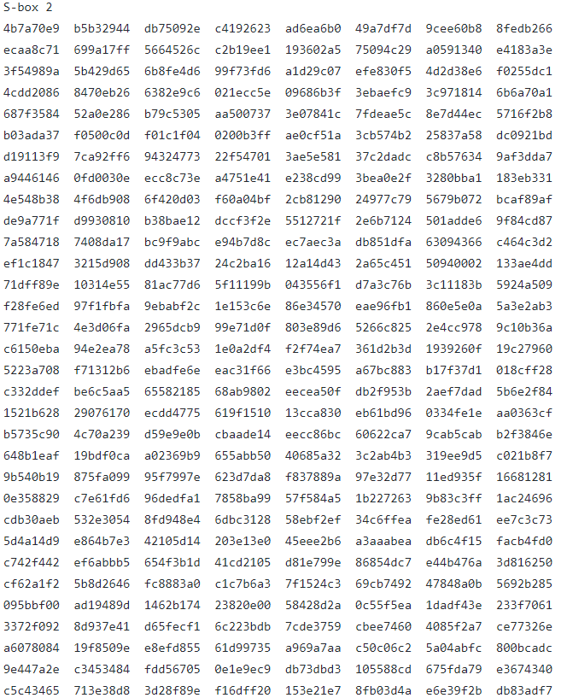
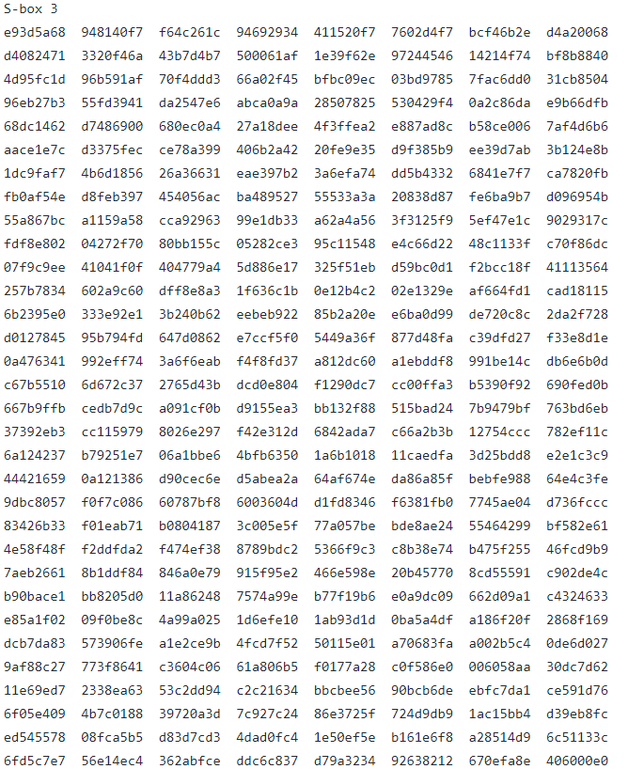
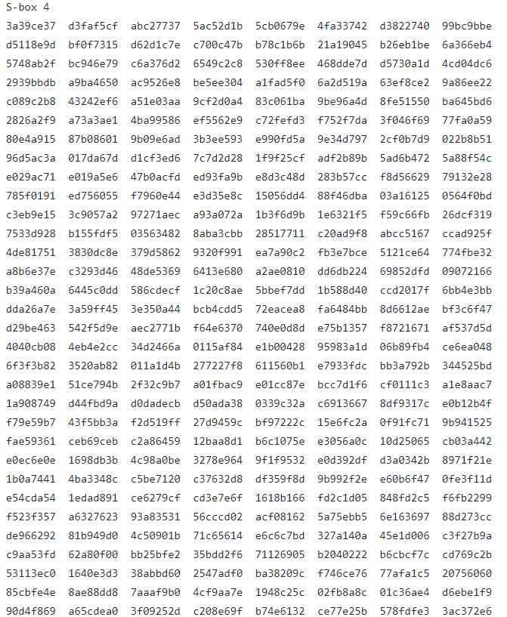

Slide 11
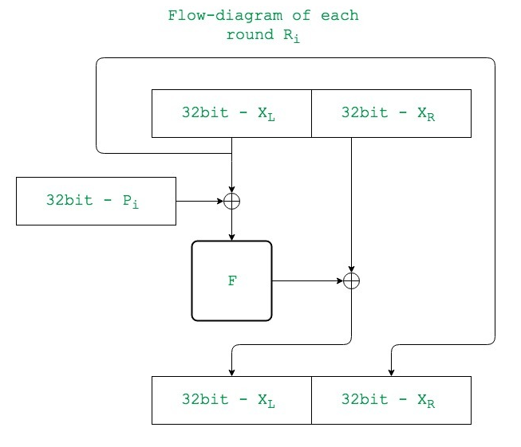
STEP 3: ENCRYPTION
3.1: ROUNDS
The encryption consists of 16 rounds with each round(Ri) taking inputs the plaintext (P.T.) from previous round and corresponding subkey(Pi).

Slide 12
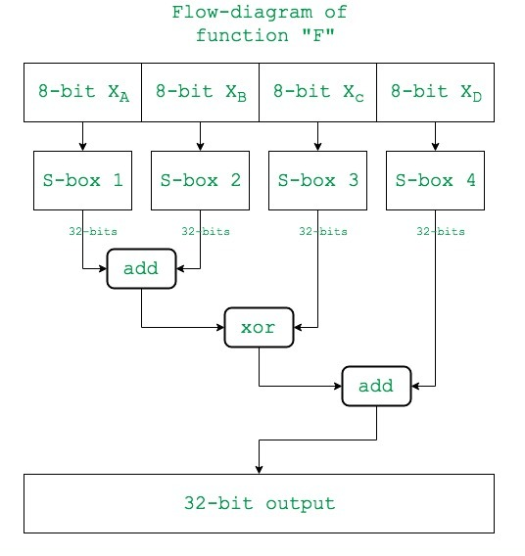
STEP 3: ENCRYPTION
3.1: ROUNDS
3.1.1: FUNCTION (F)
Here substitution boxes are usage come into picture
The process of F block is as shown in flowchart

Slide 13
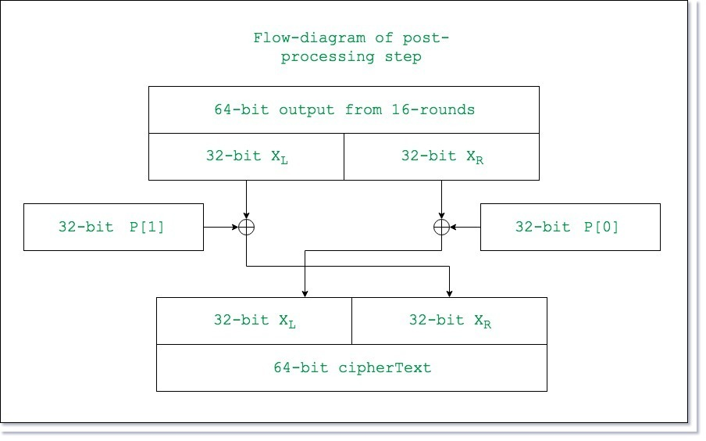
STEP 3: ENCRYPTION
3.2: POST PROCESSING
This process takes place after 16 rounds of processing
The post processing takes place as shown in flow chart
[18]
[17]

Slide 14
DECRYPTION USING BLOWFISH ALGORITHM

Slide 15
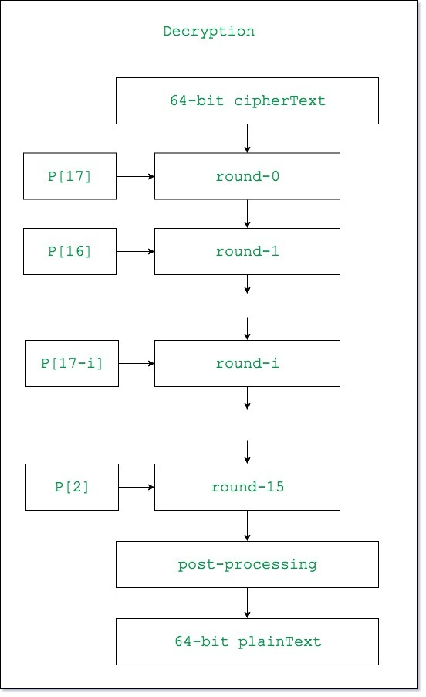
ENTIRE DECRYPTION PROCESS

Slide 16
STEP 1: Generation of subkeys
STEP 2: Initialise Substitution boxes
SAME AS IN ENCRYPTION PROCESS

Slide 17
STEP 3: DECRYPTION
3.1: ROUNDS
The decryption also consists of 16 rounds with each round(Ri)(as explained above) taking inputs the cipher Text(C.T.) from previous round and corresponding subkey(P[17-i])(i.e. for decryption the subkeys are used in reverse).
F block is as same as in Encryption

Slide 18
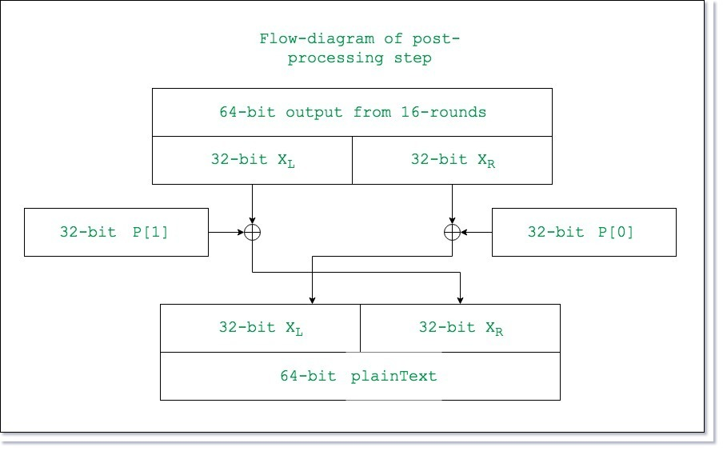
STEP 3: DECRYPTION
3.2: POST PROCESSING
This process takes place after 16 rounds of processing
The post processing takes place as shown in flow chart

Slide 19
PYTHON CODE
key = [ 0x4B7A70E9, 0xB5B32944, 0xDB75092E, 0xC4192623,
0xAD6EA6B0, 0x49A7DF7D, 0x9CEE60B8, 0x8FEDB266,
0xECAA8C71, 0x699A17FF, 0x5664526C, 0xC2B19EE1,
0x193602A5, 0x75094C29]
def calculate(L):
temp = s[0][L >> 24]
temp = (temp + s[1][L >> 16 & 0xff]) % (0x1<<32)
temp = temp ^ s[2][L >> 8 & 0xff]
temp = (temp + s[3][L & 0xff]) % (0x1<<32)
return temp

Slide 20
#ENCRYTION
def encrypt(data):
L = data>>32
R = data & 0xffffffff
for i in range(0,16):
L = L ^ p[i ]
L1 = calculate(L)
R = R ^ calculate(L1)
L,R = R,L
L,R = R,L
L = L ^ p[17]
R = R ^ p[16]
encrypted = (L<<32) ^ R
return encrypted

Slide 21
#DECRYTION
def decrypt(data):
L = data >> 32
R = data & 0xffffffff
for i in range(17, 1, -1):
L = L ^ p[i ]
L1 = calculate(L)
R = R ^ calculate(L1)
L,R = R,L
L,R = R,L
L = L^p[0]
R = R^p[1]
decrypted_data1 = (L<<32) ^ R
return decrypted_data1

Slide 22
for i in range(0,18):
p[i] = p[i]^key[i%14]
x = 0
data = 0
for i in range(0,9):
temp = encrypt(data)
p[x] = temp >> 32
x+=1
p[x] = temp & 0xffffffff
x+=1
data = temp
encrypt_data = int(input("Enter data to encrypt: "))
if encrypt_data.bit_length() <=63:
print("Valid Input!!!")
else:
print("Invalid Input!!")
data_encrypted = encrypt(encrypt_data)
print("Encrypted data is: ",data_encrypted)
print("Hex value :",hex(data_encrypted))
data_decrypted = decrypt(data_encrypted)
print("Data after decryption is : ",data_decrypted)

Slide 23

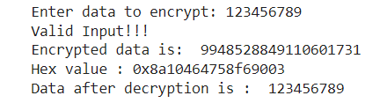
RESULT

Slide 24
ADVANTAGES
Blowfish is a fast block cipher except when changing keys.
It is faster and much better than DES Encryption.
Blowfish uses a 64-bit block size which makes it vulnerable to birthday attacks.

Slide 25
APPLICATIONS
Bulk Encryption.
Packet Encryption(ATM Packets)
Password Hashing

Slide 26


